Slide 1
Advising Online Students
Mandi Muse
Jaime Ross
Brittany Wise
Notes:
In preparation for this meeting I was reviewing the TRIO website and I noticed your goal is empower students to take control of their education and succeed in college. I love this and I know you all are making a difference. I hope this presentation will provide you with some take aways when working with onien students

Slide 2
Why?
Growth of Online Programs
Revisions to the Higher Education Act allowed colleges and universities to offer more courses online. As a result more programs are being offered.
Since the implementation of an online-only major in the PSY Department, enrollment has steadily increased.
31% increase from Fall 2018
Adult Student Services website offers complete list of our online programs
Online students are “At a higher risk” of attrition ( Morris and Finnegan, 2009)
Notes:
Prior to 2006, colleges and university were only allowed to offer up to half their courses in an online format
Who are our online students?

Slide 3
Demographics

Slide 4
Demographics Online Population is complex
Military
Study abroad
Adult learner
Going back home
Students with a Disability
First Generation
No Prior College Experience
Returning students
Caregivers
Health Issues
And more!
Notes:
Remember, our students are all unique and more than one of these situations could apply to them.

Slide 5
Misconceptions
Easier
According to COB Success Booklet, MSU courses may:
be faster paced
require more critical thinking
Require more time outside of class
May have little to no extra credit
Cheaper
In-State Tuition
$218 per credit hour for traditional course
$295 Per Credit Hour for online course
$1155 more FOR STUDENTS TAKING 15 CREDITS ONLINE PER SEMESTER
Self Paced

Slide 6
Student Experience

Slide 7
Student Experience
Online Students may encounter feelings of isolation and anxiety
Lack “contextual framework”-
buildings, faces, in-person referrals, Chalking, spontaneous conversations
Limited to hyperlinks
Electronic resources are beneficial for students, but should not be a substitute for guidance
Missed Cues
What can we do?
Create a sense of connectedness
Improving our written and oral communications skills to replicate face-to-face assistance
Work in progress
Proactive
Empathetic
Notes:
Missed cues: Online students might see a line out the do, an staff members harried look and understand if there is a delay. Online students do not have these cures. They might not have the frame of reference to under stand the perceived delay which hcan increase frustration and sense of disconnectedness
Work in process- I used to write a “Due to high volume traffic email” out of office until I recently read an article that said this can make advisor sound defensive. Tend to create a softer version.
An example would be “I’m sorry I wasn’t able to call you back sooner. How are you? Calling the student by their name
Coud elaborate on electronic resources , page 2 of Ohrablo
So this is complex. We have students from varying walks of life, possibly under the wrong assumptions of what their experiences will be, who might be spending more than their counterparts and who feel isolation and anxiety. What can we do!?
.

Slide 8
Hurdles

Slide 9
Hurdles
Internet service
Knowledge of campus services, procedures, and policies
Administrative Barriers
Non-comprehensive degrees and online minors
Academic integrity
Managing expectations of online programs/courses
Time management
Work life balance
Graduate School Preparation
Online Programs and lack of programs
Mth 101 is not offered online
Gen Ed: Physical Sciences lab option
Diversity studies minor requires service learning
Periodicity
Proctored Exams

Slide 10
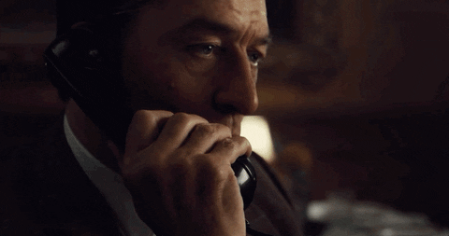
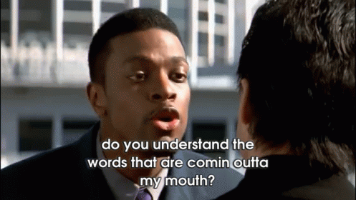
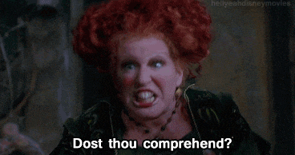
Communication

Slide 11
Communicating with Online students
Recognize preferred Devices
56% online college students used a smart phone or tablet to complete some course related activity.
2/3rds of prospective online college students would prefer to use a mobile device to complete course work
(Clinefelter, Aslanian, & Magda, 2019).
Inclusivity
Detailed
Flexibility
Tend to have full schedule, anything we can do to help is beneficial
Expectations
Email Etiquette
Important dates and deadlines
How to resolve conflicts
Remind students to check email and its importance
Establish consistency in processes (how to book with an advisor, how to access resources, etc.)
Notes:
Detailed- TR, First Gen personal anecdote. Don’t assume they know how the campus operates .
Expectations- Might be more transactions, customber service, might need more growth
Inclusitivity- We statemetns, still make aware of opportunities

Slide 12
Communication
Phone
Email
Able to discern emotion, motivation and concerns more than email.
Good time to talk?
Anticipate Silence
Bad reception, disconnected calls, lack of response
Voicemail not set up/bad numbers
Anticipate Distractions
Multitasking, Driving, at work, etc.,.
You’ve got mail
Easy to view as an administrative task rather than advising.
Take time to respond to emails similar to time spent when interacting with students face-to Face
Provide information student did not request
Anticipate Needs and explore options
Integrate interpersonal exchanges
Can be utilized as a historical reference
Notes:
Lack visual Cues- We cannot see anxiety on someones face, we can only infer tone or use of written word
Distractions: Rowdy friends in background, cat bringing in dead bird, dropping off kids, driving
You’ve got mail-Allows students to communicate on their own timeline. Might be preferred method and it might take longer to find a solution to a student’s question or it can be more informal to build the relationship
Provide Information Student did not request:
Example: When is the registration deadline?
Remember, would you quickly answer the question and usher the student out of the office?
Do they have holds, what are they registering for? Is there a sequencing? Deadline?
It’s good to hear from you, Congratulations on nearing completion of your program, you are close to graduating, keep up the great work! Great question!
Triage- If I’m spending an inordinate amount of time on email with a student or it is obvious something is wrong, I’ll ask to call them.

Slide 13
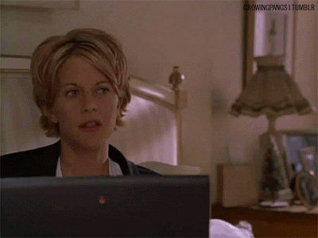
Communication
Zoom
Offered at MSU
Most closely mirrors face to face interactions
Helps avoid distractions
More collaboration- see computer screen and review resources at same time
Downside: Technical Difficulties
Notes:
My strategy- Call during Zoom appointment, ensure they received the email, know how to access zoom, know how to use functions.

Slide 14
Tools And Technology
Zoom Meeting
Calendar/Scheduling apps
texting
Student support services
Computer Help Desk
DRC/ LDC
Bear claw
Career center
Proctoring center
Adult Student Services
Notes:
Calendar to follow up

Slide 15
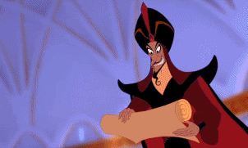
Checklist

Slide 16
Checklist
Did I include a greeting or warm statement?
Did I provide the information that the student requested and anticipate the student’s need by providing additional information?
Example: Registration Example
Did I reinforce student successes and establish a sense of shared responsibility?
Did I establish a clear outline of the next steps and invite follow up communication?
Example:
Please do not hesitate to contact me with additional questions, comments, or concerns. I look forward to hearing from you!
Calendar reminders to follow up

Slide 17
References
Clinefelter, D. L., Aslanian, C. B., & Magda, A. J. (2019). Online college students 2019: Comprehensive data on demands and preferences. Louisville, KY: Wiley edu, LLC
Missouri State University Business Advisement Center (2019).College of Business Success Booklet. Retrieved from:. https://www.missouristate.edu/assets/busadv/COBSuccess2018-2019.pdf
Morris, L. V., & Finnegan, C. L. (2009). Best practices in predicting and encouraging student persistence and achievement online. Journal of College Student Retention, 10(1), 55-64.
Ohrablo, S. (2016). Advising online students: Replicating best practices of face-to-face advising. Retrieved from the NACADA Clearinghouse of Academic Advising Resources Web site: http://www.nacada.ksu.edu/Resources/Clearinghouse/View-Articles/Advising-Online-Students-Replicating-Best-Practices-of-Face-to-Face-Advising.aspx

Slide 18
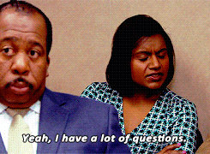
Questions???

