Slide 1
Advising New American Undergraduates: Challenges & Opportunities
Nancy childrey Ph.D.
MACADA 2019
Notes:
Hello and welcome to my presentation about Advising New American Undergraduates: Challenges and Opportunities! My name is Nancy Childrey and I am an academic advisor at Saint Louis University! I hope you are ready to hear some stories because this topic hits very close to home for me. I’ll explain more in a bit!

Slide 2
Outline of Presentation
Understanding legal statuses
Video
General facts
Focus on first-generation and second-generation immigrant students
Understanding their challenges
Opportunities
Reflection
Notes:
To give you an idea about what I’ll be presenting on, I wanted to show you the outline of this presentation. When I created this presentation, I actually drew it from a presentation I did a year ago with another advisor and a graduate student. Last year I had the opportunity to supervise a graduate student. During the time of supervision I gave her a task to study about a group that she wanted to learn more about. But before we talk about New American Undergraduates, I wanted to cover some basic information that I don’t want to assume you already know. Then we’ll watch a video, learn some general facts, and then narrow our focus on first and second-generation immigrant students. We’ll cover some of their challenges and hear opportunities to help them succeed in college. At the end, I’d like for you to get in a small group to discuss some reflection questions and we’ll come together as a big group to discuss what you found interesting and helpful.

Slide 3
Legal Statuses
definitions

Slide 4
U.S. Citizen
An individual born in the U.S.
An individual whose parent is a U.S. citizen
A former alien who has been naturalized as a U.S. citizen
An individual born in Puerto Rico
An individual born in Guam
An individual born in the U.S. Virgin Islands (IRS, 2018)
Notes:
Immigration Terms and Definitions Involving Aliens, IRS, updated 01/10/2018, accessed 01/16/2018, https://www.irs.gov/individuals/international-taxpayers/immigration-terms-and-definitions-involving-aliens

Slide 5
Illegal Alien
"Undocumented Alien"
Entered the U.S. illegally OR entered the U.S. legally, but who has fallen "out of status" and is deportable
Deferred Action for Childhood Arrivals (DACA)
(IRS, 2018)
Notes:
Immigration Terms and Definitions Involving Aliens, IRS, updated 01/10/2018, accessed 01/16/2018, https://www.irs.gov/individuals/international-taxpayers/immigration-terms-and-definitions-involving-aliens

Slide 6
Refugees & Asylees
Refugees
Asylees
People, typically outside of their country, who are unable or unwilling to return home because they fear serious harm
May have a form of protection granted to people who are of special humanitarian concern
Meet the definition of refugee
Are already in the U.S.
Are seeking admission at a port of entry (USCIS, 2015)
Notes:
Refugees & Asylum, reviewed 11/12/2015, accessed 01/16/2018, https://www.uscis.gov/humanitarian/refugees-asylum

Slide 7
Legal Alien
Immigrant
Non-immigrant
An alien who has been granted the right to reside permanently and work without restrictions in the U.S.
All immigrants are eventually issued a "green card" - evidence of Legal Permanent Resident (LPR) status
Immigrant visas (IRS, 2018)
An alien who has been granted the right to reside temporarily in the U.S.
Nonimmigrant visas include
F-1 student status
Notes:
Immigration Terms and Definitions Involving Aliens, IRS, updated 01/10/2018, accessed 01/16/2018, https://www.irs.gov/individuals/international-taxpayers/immigration-terms-and-definitions-involving-aliens

Slide 8
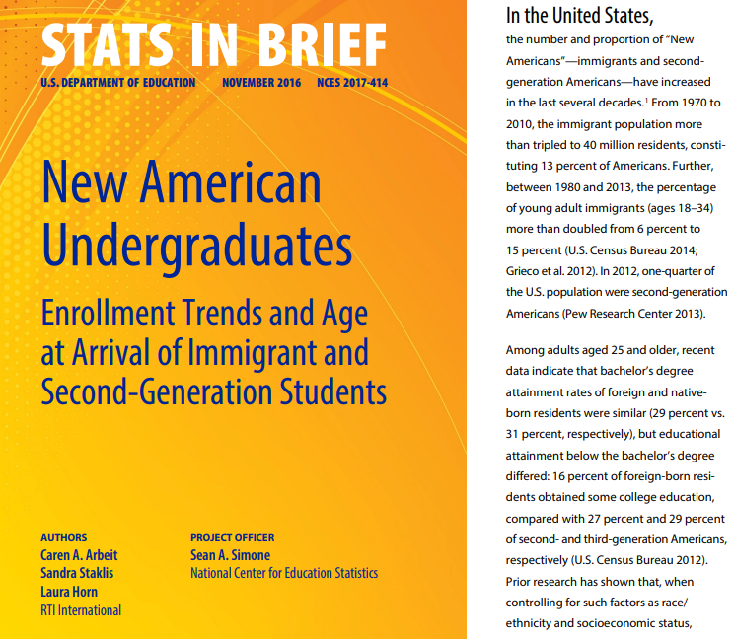
New Americans
First-generation immigrants – born abroad
Second-generation immigrants – born in the U.S.
At least one parent was born abroad (U.S. Department of Education, 2016)

Slide 9
Video: Helene Nguyen
https://www.youtube.com/watch?v=uiQ_juE2t40

Slide 10
General Facts
13% of Americans are immigrants
40 million
25% of Americans are second-generation immigrants
Immigrants & second-generation Americans are the fastest growing population within the American education system

Slide 11
SLU Facts
14 undergraduate first-generation students*
Students whose country of origin is not the U.S., but the current country of citizenship is the U.S.
Austria, China, India, Pakistan, Spain, Uzbekistan
Country of origin is not a required question on the admission application for SLU
Notes:
6 India, 2 Pakistan

Slide 12
Immigrant-specific considerations
Length of time in the U.S.
Child arrivals: 0-11 years old
Adolescent arrivals: 12-17 years old
Adult arrivals: 18+ years old (U.S. Department of Education 2016)
Type of ESL support received
Type of U.S. school system
Private vs. public
Notes:
U.S. Department of Education, National Center for Education Statistics, … (2016).

Slide 13
Immigrant-specific considerations
Language spoken at home
Parental knowledge of English
Strength of ties to the respective immigrant community in the U.S.
Length and type of education in the country of origin
(Ousey, Brown, and Goldschmidt, 2014)
Notes:
U.S. Department of Education, National Center for Education Statistics, … (2016).

Slide 14
Practical considerations
Language development:
2-3 years for speaking skills
5-7 for reading, comprehension, and analytical skills
Lack of challenging material
High school remedial courses
GPAs vs. ACT/SAT scores
Unfamiliar with college expectations
First-generation students
Cultural references (Ousey, Brown, and Goldschmidt, 2014)
Notes:
Good GPAs may be representative of students’ hard work, while their actual level of academic achievement is represented by lower standardized tests scores
ACT/SATs are more difficult to master than to work well in school
Cultural references: may not understand cultural references, especially if grow up in close connection with their respective community and English is not the primary language spoken at home
Low cultural capital

Slide 15
Panel Introduction

Slide 16
Panel Questions
How does your experience as an immigrant impact your education in the U.S.?
What do you think has been different about your experience compared to domestic students?
Which areas are most challenging for you – social, academic, cultural adjustment?
Can you give examples of what these challenges look like for you?
Do you feel like you fit in at your university? Why or why not?

Slide 17
Panel Questions (cont.)
Have you experienced any academic concerns specifically because of your immigrant status?
What have you done to address these concerns?
What support services do you think would help you be more successful in the university environment?
What advice would you give to academic advisors when working with immigrant students?
What is the most effective way for advisors (and other professionals on campus) to support immigrant students without directly asking about their immigrant status?

Slide 18
Students’ Reflections
Biggest Adjustments faced in college was in the classroom
“Discussion and class participation may not come easily to immigrant students, because oftentimes discussion isn’t used as a pedagogic method in other countries”
“Immigrant students may be hesitant to speak up and voice their opinions, for fear of seeming disrespectful or questioning authority.”
“The U.S. education system teaches you to think critically, which doesn’t always translate well in other cultures, where the same behavior may be seen as questioning authority.”

Slide 19
Students’ Reflections
Differences in cultural norms between their country of origin and the U.S. can impact immigrant students’ interactions with faculty
“Sometimes it’s unclear how to approach or address faculty, because the English language doesn’t differentiate between a formal and an information salutation or way of addressing someone.”
“It’s difficult to understand how to show respect and to translate your personal and culturally-motivated values related to respect in a culture and education system that doesn’t account for such values as part of the language structure.”

Slide 20
Students’ Reflections
What do you think has been different about your experience compared to domestic students?
“Immigrant students have a lot more to deal with, for example helping family members who don’t speak English, working on the side, trying to understand how the healthcare system works, etc.”
“Immigrant students may get more out of their education in the U.S. because they work harder to get it, and they appreciate their education to a higher degree because of that.”

Slide 21
Students’ Reflections
What do you think has been different about your experience compared to domestic students?
“ You learn to work hard and from an early age as a second-generation immigrant because you see what your parents have gone through and what they’ve sacrifice in order for you to be where you are- for example, in college.”

Slide 22
Students’ Reflections
How can the academic advising community better support student immigrants?
Focus on relationship building by welcoming and asking thoughtful questions about a student’s background without making assumptions beforehand!
“Asking students if they speak other languages, instead of asking them about their immigrant status.”
“Be open to hear a person’s story. A simple ‘tell me about yourself’ goes a long way.”

Slide 23
Students’ Reflections
How can the academic advising community better support student immigrants?
Have sessions for student immigrants and their families during orientation.
Be more cognizant of their different learning needs and make class recommendations and referrals for support services based on those needs would be helpful.
i.e. TRiO-Support Services
Writing Services
International Courses

Slide 24
Reflection Activity
Break up into groups of 3 or 4 individuals
Guiding questions
Reflection as a large group after discussion

Slide 25
Reflection Questions (5)
How can you identify “invisible” immigrant students?
Can you think of your current advisees, who would fall into this category?
What support services can you offer to these students?
What collaborative partnerships on campus can be particularly helpful when working with immigrant students?
Which advising techniques would you utilize?
What additional information would you like to have in order to be a more effective advisor for this student population?

Slide 26
Thank you for attending!
Nancy Childrey
Nancy.childrey@slu.edu
314-977-8234

Slide 27
References
Internal Revenue Service (2018). Immigration terms and definitions involving aliens. Retrieved from https://www.irs.gov/individuals/international-taxpayers/immigration-terms-and-definitions-involving-aliens
[K-State College of Education]. (2014, November 10). A Walk in my shoes: first generation Helene’s story [Video File]. Retrieved from https://www.youtube.com/watch?v=uiQ_juE2t40&feature=youtu.be
Ousey, D.L., Brown, C. F., & Goldschmidt, M. M. (2014). Developmental immigrant students: What cross-disciplinary faculty should know. Research & Teaching In Developmental Education, 30(2), 65-79.
U.S. Citizenship and Immigration Services (2015). Refugees & asylum. Retrieved from https://www.uscis.gov/humanitarian/refugees-asylum
U.S. Department of Education, National Center for Education Statistics, Institute of Education Sciences (2016). New American undergraduates: Enrollment trends and age at arrival of immigrant and second-generation students (NCES 2017-414). Retrieved from https://nces.ed.gov/pubs2017/2017414.pdf
Helpful Resources
Burzstyn, A., & Korn-Burzstyn, C. (2015). Immigrant Children and Youth: Psychological Challenges. Santa Barbara, California: Praeger.

Slide 28
https://bit.ly/2ZzmryO
Online Concurrent Session Evaluation

